Slide 1

Java 8 – Lambda’s
---Vinay Kumar Yadav

Slide 2

Introduction of Lambda’s
Why Lambdas was introduced?
Before Java 8, if you needed to create anonymous inner classes for things like:
Callbacks
Event listeners
Comparators
...the code would become verbose (meaning it contained more words than necessary) and hard to read.
Essentially, Lambdas were introduced to simplify and shorten the code required for these common scenarios, making it more readable and less cumbersome (meaning less complicated and unwieldy).

Slide 3
What is a callback?
A callback is a method (a piece of code) that is passed as an argument to another method. The receiving method then calls or "calls back" this method later, often when a task is finished, or an event occurs.
Common uses: Handling button clicks, completing an asynchronous task (like downloading data), or executing code in a separate thread.

Slide 4
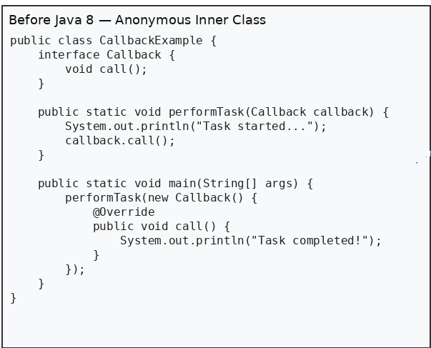
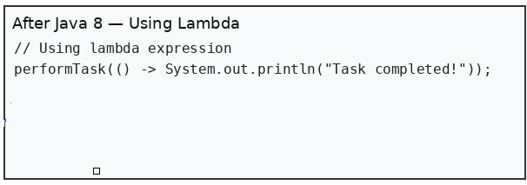
Example code for callbacks
Why Lambdas are Better (Key Points)?
Removes anonymous inner class boilerplate (no new class required).
Code is shorter and more expressive.
Easier to read and maintain.
Enables functional-style programming and works well with Streams.
Lambdas capture final or effectively-final variables (safer closures).
Problem: This required six lines of boilerplate (creating new Callback(), the @Override annotation, and the method signature public void call()) just to execute one line of actual work. This is the cumbersome (meaning less complicated and unwieldy) part the previous text referred to.

Slide 5
What is an event listner?
An Event Listener is an object that waits for an event to occur (like a button click, mouse move, key press, etc.) and executes specific code in response to that event.
In simple words:
Event Listener = “When this happens, do this.”
Example:
Button clicked → run some code
Mouse moved → update UI
Key pressed → validate input
In Java, an event listener is usually an interface (like ActionListener) with a method that gets called automatically when the event happens.

Slide 6
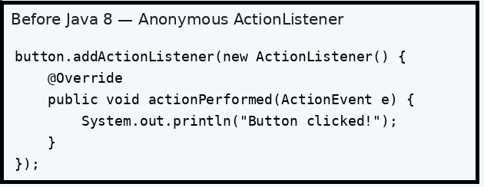
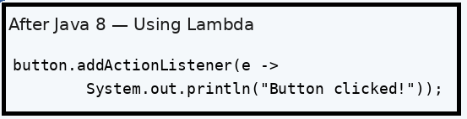
Example code for Event Listeners
The problem is that anonymous inner classes made event listener code too long and filled with unnecessary boilerplate.
Why Lambda Version is Better
Cleaner syntax – no repeated interface or method name
Reduces boilerplate (no ActionListener class block)
More readable and focused code
Captures context easily when needed
Works seamlessly with functional programming style

Slide 7
What is comparator?
A Comparator is an interface in Java used to define custom sorting logic for objects.
Simple definition:
👉 Comparator = a rule that tells Java how to compare two objects.
Why we use it:
To sort objects in a specific order (ascending, descending, by name, by age, etc.)
To provide sorting logic outside the class (unlike Comparable which is inside the class)
Example:
If you want to sort strings alphabetically, the comparator decides how two strings should be compared:
(o1, o2) -> o1.compareTo(o2)
You can use a comparator to sort by:
Name
Age
Salary
Any custom condition
So, Comparator = custom sorting logic provider.

Slide 8
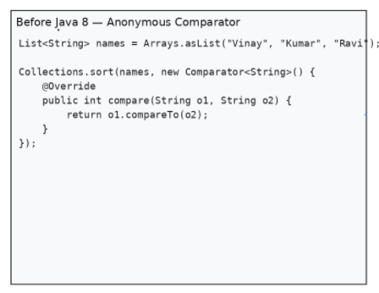
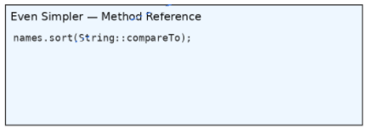
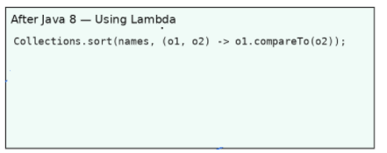
Example code for comparators
Why Lambdas & Method References Are Better
Removes verbose anonymous Comparator class
Lambda syntax is shorter and easier to read
Method reference is the cleanest and most expressive form
Improves code clarity in sorting and stream operations
Reduces boilerplate and focuses only on comparison logic.

Slide 9
What is runnable?
A Runnable is a functional interface in Java that represents a task or piece of work that can be executed by a thread.
Simple Definition:
👉 Runnable = a task that a thread can run.
Key Point:
It has only one method:
void run();
Whatever code you put inside run() is what the thread will execute.
Example:
Runnable task = () -> System.out.println("Task is running!");
new Thread(task).start();
So, Runnable is simply a unit of work that can run in a separate thread.

Slide 10
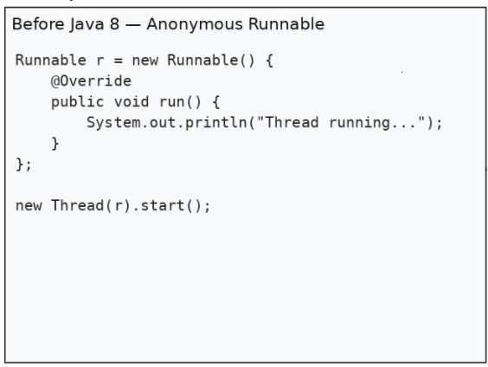
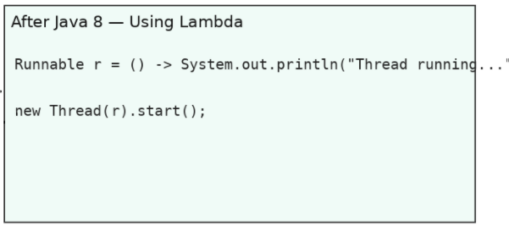
Example code for Runnable
Why Lambda Version is Better
Cleaner syntax – no anonymous inner class required
Removes unnecessary boilerplate code
More readable and concise
Ideal for functional programming style
Works smoothly with threads and executor services

